Slide 1
Cancer Gene Expression Classification Using Transfer Learning and Explainable AI
NAME: ANTHONY OMOWUMI
B00892305

Slide 2
OUTLINE
Introduction
Aim of the Study
Dataset Description
Method & Materials
Data Modelling & Implementation
Experimental ​Results and Discussion
Conclusion & Future Works

Slide 3
Introduction
Cancer is one of the leading causes of death worldwide according to the World Health Organization (WHO), accounting for close to 10 million deaths in 2020, or close to 1 in 6 deaths [1].
Gene Expression Analysis provides information about the roles played by different genes and has become an essential approach for overcoming difficulties in cancer detection and medication discovery [2].
Gene Expression Analysis is a complex process due to relatively few samples available with high dimensional data.
Recently, deep learning algorithms have been applied and achieved better performance compared to traditional methods [3], but deep learning algorithms require a huge amount of data for training purposes which is lacking in a gene expression dataset.
This study seeks to employ the use of deep learning algorithms in an approach called “Transfer Learning” as well as “Explainable AI” to enable the end user to understand, interpret, and trust the outcome of the classification results

Slide 4
Aims & Objectives
The aim of the study is to employ the use of Transfer Learning to classify 33 prevalent tumor gene expressions and Explainable AI – IntegratedGradients was used to check the attribution of the image predicting a specific class label (A particular Tumor).
This is to understand the part of the images/genes leading to the prediction of the outcome and to find out if the Transfer learning approach will work well with the dataset complexities (Relatively few samples available with high dimensional data) with less computational resources.
Notes:
1. To find out if the Transfer learning approach will work well with the dataset complexities (Relatively few samples available with high dimensional data)
2. To bring the use of Explainable AI into the processes to enable interpretability of the models working and why it is predicting a specific class label
3. The image produced in this study contains gene samples across the 33 classes of tumors.

Slide 5
DATASET DESCRIPTION

Slide 6
Overview of the dataset
A level 3 normalized 33 prevalent tumor types of RNA-Seq gene expression data from Pan-Cancer Atlas was used in the study.
It is a publicly available dataset with 20531 gene expression counts with 1 classification column (Tumor gene expression types) and 10446 tumor samples (rows). Pan-Cancer Atlas.
The 20531 column was further reduced to 10363 gene expression for the analysis.
Notes:
Publicly available RNA-Seq Expression data (Secondary data) are used in this work [10]. The Cancer Genome Atlas (TCGA) has sequenced and handled a sizable quantity of tumor tissues. From these samples, TCGA further evaluated over 11,000 tumors from the 33 most common types of cancer, which enabled the creation of the Pan-Cancer Atlas. The National Cancer Institute (NCI) and the National Human Genome Research Institute jointly founded the TCGA project in 2006 with the goal of customizing and identifying the genetic mutations responsible for various cancer types using genome sequencing and bioinformatics [12]. Pan-Cancer Atlas The Python programming language and its packages are used in this investigation. For data mining, data modeling, validation, testing, and explainability/interpretability, libraries such as TensorFlow, Keras libraries, and Alibi Explain were installed and used [13].
This was done by using a Variance Threshold of 1.19 to filter out genes whose samples remain almost unchanged across the expression levels, and manually filtering our irregularities in the dataset

Slide 7
MATERIALS & METHODS

Slide 8
Methods
PHASE I
PHASE II
DATA PREPROCESSING & TRANSFORMATION
EXPERIMENTAL SETUP
Feature Selection
Log Transformation and Image Synthesis
Transfer Learning
Explainable AI
VGG19
DENSENET169
XCEPTION
RESNET50

Slide 9
Phase I : Data Pre-processing and Transformation
STEP I: FEATURE SELECTION
Matching with annotation files from NCBI (National Center for Biotechnology Information) that contain records of genes to filter out those not found in the file.
A variance threshold of 1.19 was used to filter out and reduce the gene expression features by disqualifying zero variance features
This finally reduces the features from 20531 to 10363. This was also manually inspected in the Excel file [3].
STEP II: LOG TRANSFORMATION AND IMAGE SYNTHESIS
A log transform was used; y = logbase2(x + 1) to reduce the scale of the expression count of the genes
The data was reshaped from a 10363x1 array into a 102x102 image by adding zeros at the last line of the image. The images were normalized
The images were then converted to a greyscale image with a single channel which was converted to having 3 channels through a channel duplication mechanism – with the ImageGenerator function in Keras.
Notes:
Variance Threshold is used to reduce the ranges of the expression read count for the gene are enormous while some values are smaller than 1.
The image was normalized to make sure the range was between [0, and 255].
In image processing, normalization is a process that changes the range of pixel intensity values. Normalizing images helps to reduce overfitting by preventing the model from memorizing the pixel values of the training data. This is because the normalization procedure removes any unnecessary variations in pixel values, which could cause the model to learn spurious patterns.
The images were then converted to a greyscale image with a single channel which was converted to having 3 channels through a channel duplication mechanism- it was achieved using the ImageGenerator (Image_dataset_from_directory) function in Keras to allow the images to fit the pre-trained models

Slide 10
Phase I : Data Pre-processing and Transformation
STEP III: TRANSFER LEARNING
The pre-trained base models mentioned above underwent fine-tuning, which involved freezing some model parts, retraining some model blocks/layers, and retraining the Fully Connected layer.
The pre-trained models used in this study include VGG19, DenseNet169, Xception and ResNet50
STEP IV: EXPLAINABLE AI
Integrated Gradients generate an attribution value for each feature (in this case, for each pixel and channel in the image). The Green attribution talks about the part of the image/features contributing positively to the prediction of the class label while the red attribution indicates the part contributing negatively to the prediction.
Integrated Gradients were used to check the attribution of the image predicting a specific class label. This is to understand the part of the images leading to the prediction of the outcome
Notes:
UNDER TRANSFER LEARNING: Since none of these qualities—that is, the characteristics of medical data—are present in the objects or images used to train the models, this approach was carried out to enable some layers of the models to learn patterns or forms in the medical data.
UNDER EXPLAINABLE AI: The Integrated Gradients method is a way to make a classification model interpretable.
It can be used for all models that are differentiable, i.e. derivable. This includes, for example, neural networks, but not the basic machine learning models, such as Random Forest or Linear Regression.
Applications of the Integrated Gradient method include, for example, finding out the feature importance, debugging models, as well as improving the data set with respect to the important features.
A baseline is defined that has no effect on the classification result. Then, in a few steps, interpolations are given to the model, and the gradient is used to determine what influence the individual inputs have on the result.

Slide 11
Phase II : Experimental Setup
The pre-trained models used in this study include VGG19, DenseNet169, Xception and ResNet50.
Four models—VGG19, ResNet50, DenseNet169, and Xception—were chosen after experimenting with a variety of base CNN pre-trained model architectures, including EfficientNetB0, MobileNet, and others.
VGG19 is a deep architecture CNN network of 19 layers, including 1 SoftMax layer, 5 max-pooling layers, 3 fully connected layers, and 16 convolutional layers.
DenseNet169 was created to maximize accuracy by avoiding the vanishing gradient problem and feature mappings that reduce parameter efficiency. A variant of densely linked convolutional networks.
ResNet turns a conventional network into a residual network by "skipping over" some levels using the idea of shortcut connections. It decreases the number of parameters and matrix multiplication to speed up the training of each layer.
A deep convolutional neural network called Xception, which is an extreme variant of Inception, uses depth-wise Separable convolutional.
Notes:
1. VGG19 is a deep architecture CNN network of 19 layers, including 1 SoftMax layer, 5 max-pooling layers, 3 fully connected layers, and 16 convolutional layers.
2. DenseNet169 was created to maximize accuracy by avoiding the vanishing gradient problem and feature mappings that reduce parameter efficiency. A variant of densely linked convolutional networks.
3. ResNet turns a conventional network into a residual network by "skipping over" some levels using the idea of shortcut connections. ResNet50 builds on a bottleneck design of 1x1 convolution, employs a stack of three layers rather than two levels, and decreases the number of parameters and matrix multiplication to speed up the training of each layer.
4. A deep convolutional neural network called Xception, which is an extreme variant of Inception, uses depth-wise Separable convolutional.

Slide 12
DATA MODELLING

Slide 13
Data Modelling & Implementation
The classes were represented with numerical values ranging from 0 to 32, where 0 stands for ACC and 32 is the last class UVM.
The 33 image class data were randomly split using the split-folder package in Python in the ratio of 80:10:10 for the model training, validation, and testing of the model's performance.
A prediction-dense layer with a SoftMax activation, an Adam optimizer, and a learning rate of 10e-4 was used when fitting the models. To enhance generalization performance and avoid overfitting, Dropout, and L2 kernel regularization were applied.
For multiclass classification problems utilized in the training of the models, the loss function is CATEGORICAL CROSS-ENTROPY (It Computes the cross-entropy loss between the labels and predictions.), and a training epoch for all the models was 25 except for Xception trained at 15 epochs.
Notes:
Also, the images were modified into 3-channel images through a channel duplication mechanism allowing the pre-trained model to process the images as RGB channel images. The grayscale intensity is essentially used as the value for all three color channels in the model, which handles all three channels equally by the models [15], [16].
A prediction-dense layer with a SoftMax activation, an Adam optimizer, and a learning rate of 10e-4 was used when fitting the models, this is to at least ensure that the models learn some patterns in the medical data. To enhance generalization performance and avoid overfitting, Dropout, and L2 kernel regularization were applied. For multiclass classification problems utilized in the training of the models, the loss function is categorical cross-entropy (Computes the cross-entropy loss between the labels and predictions.), and a training epoch for all the models was 25 except for Xception trained at 15 epochs.

Slide 14
EXPERIMENTAL RESULTS

Slide 15
Results
Table 1: Results of the fine-tuned pre-trained models
Table 2: Performance metric results of the fine-tuned pre-trained models on 10% Test data
Fine-Tuned Classification Model | ACCURACY PERFORMANCE ON THE TRAIN, VALIDATION AND TEST DATASET
 | Train Accuracy (80%) | Valid Accuracy (10%) | Test Accuracy (10%)
Xception | 99.69% | 91.75% | 90.00%
DenseNet169 | 98.20% | 92.33% | 91.00%
VGG19 | 95.26% | 91.76% | 91.00%
ResNet50 | 1.00% | 94.08% | 92.00%
Fine-Tuned Classification Model | PERFORMANCE METRICS ON 10% TEST DATA
 | Precision | Recall | F1-Score | Accuracy
Xception | 88% | 86% | 86% | 90%
DenseNet169 | 89% | 86% | 87% | 91%
VGG19 | 87% | 86% | 86% | 91%
ResNet50 | 90% | 88% | 89% | 92%
Notes:
Inspecting the performance metrics, accuracy was less considered in this study because the data contains an imbalance class distribution. Therefore, taking the performance metrics of the ResNet50 architecture, the precision of 90% explains that when the model predicts a tumor presence, there is a 90% chance that the model is accurate while Recall/Sensitivity of 88% indicates that the model correctly predicted 88% of the actual tumor instances. In other words, the model has an 88% chance of discovering and predicting a tumor when one is present

Slide 16
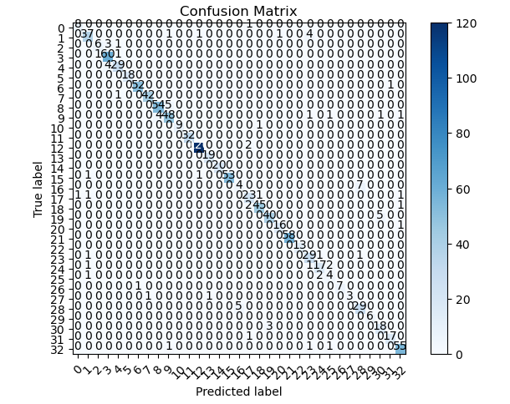
Confusion Matrix for ResNet50 on 10% Test Data
The generated confusion matrix of ResNet50 on the 10% test data of 1074 (unseen during training) is shown in “Figure 5”. The purpose of the test data is to evaluate the performance of the model. Looking at the confusion matrix shows some misclassification of some of the classes.
7 of class 16 (LIHC) samples were misclassified as class 28 (THCA) while 5 samples of THCA were misclassified as LIHC.
5 of class 19 (OV) samples were misclassified as class 30 (UCEC) while 3 of UCEC samples were misclassified as OV samples.
4 class 1 (BLCA) samples were misclassified as class 23 (READ) while 1 of READ was misclassified as BLCA.
According to paper [3], READ class and LIHC were also misclassified. This misclassification could be due to small samples in the test data since it only contains 10% of the total dataset in this study and the class distribution is not evenly distributed. It is an imbalanced dataset.
Notes:
The generated confusion matrix of ResNet50 on the 10% test data of 1074 (unseen during training) is shown in “Figure 5”. The purpose of the test data is to evaluate the performance of the model. Looking at the confusion matrix shows some misclassification of some of the classes.
i. 7 of class 16 (LIHC) samples were misclassified as class 28 (THCA) while 5 samples of THCA were misclassified as LIHC.
ii. 5 of class 19 (OV) samples were misclassified as class 30 (UCEC) while 3 of UCEC samples were misclassified as OV samples.
iii. 4 class 1 (BLCA) samples were misclassified as class 23 (READ) while 1 of READ was misclassified as BLCA.
According to paper [8], READ class and LIHC were also misclassified. This misclassification could be due to small samples in the test data since it only contains 10% of the total dataset in this study and the class distribution is not evenly distributed. It is an imbalanced dataset.

Slide 17
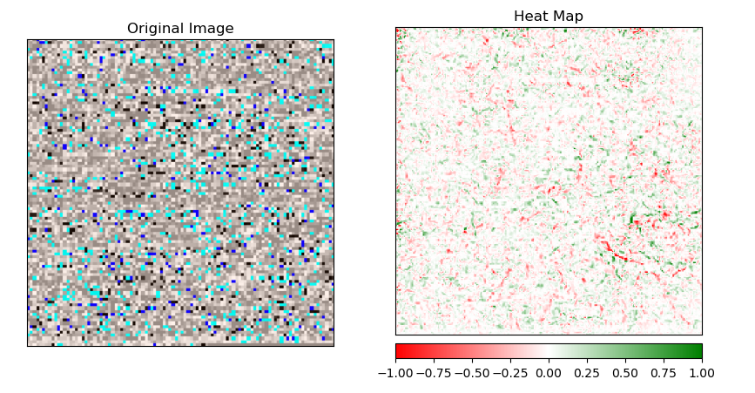
Red & Green attribution for class prediction in ResNet50
Using the IntegratedGradients library from ALIBI Explainers in Python to get the interpretability of the pre-trained model (RESNET50). An image from class 1/BLCA was pre-processed and transformed using the RESNET50 preprocess input library in the TensorFlow Keras library. The pixel's attribution value is obtained by adding the three-color channels' individual attribution values. The green color on the heatmap represents positive attributions, whereas red color represent negative attributions. The attributions are scaled in a range and show which genes or portions of the image are responsible for the observed results.
Notes:
To get the interpretability of the model prediction, IntegratedGradients was imported from Alibi Explainers. An image from class 1 (BLCA) was used to inspect this. The image was preprocessed and transformed using the ResNet50 preprocess input library in the TensorFlow keras library. “Figure 6” shows the explainability of the model prediction and why it is predicting the class label “BLCA/class1” in the code. By overlaying the attribution values for each pixel over the original image on the heatmap with the black image baseline, the attributions are shown. The pixel's attribution value is obtained by adding the three-color channels' individual attribution values. Green pixels represent positive attributions, whereas red pixels represent negative attributions. The attributions are scaled in a range and show which genes or portions of the image are responsible for the observed results.

Slide 18
CONCLUSION

Slide 19
Conclusion
Results in this study show that the pre-trained model - VGG19, Xception, DenseNet169, and ResNet50 with a procedure involving retraining of some part of the convolutional layer/block to learn some patterns/forms in the gene expression/medical data is good in classifying gene expression data.
ResNet50 performed better in this study achieving an accuracy of 92% on the 10% test set with a precision of 90%, recall of 88%, and F1 score of 89%. This performance on the unseen data (test data) shows that there is a good generalization performance of the model.
Transfer learning and base models’ architectures fine-tuning can work well to identify tumor types based on their gene expression and will work well with other tumor types not included in this study as well as other genomics data analysis. It is faster and less computationally expensive.
The use of IntegratedGradients on the images gives a clearer view of which part of the image is attributing the cause of the prediction of the various classes. It is shown in this work that a good generalization performance is achieved.
Notes:
In this study, based on the Pan-Cancer Atlas provided 33 most prevalent tumor types, a transfer learning methodology to classify genomic data (Gene Expression data) was employed. The experimental result in this study shows that the pre-trained model- VGG19, Xception, DenseNet169, and ResNet50 with a fine-tuning procedure like retraining of some part of the convolutional layer/block to effectively learn some patterns/forms in the gene expression/medical data and the common fully connected layer retraining method of the models is good in classifying gene expression data. ResNet50 performed better in this study achieving an accuracy of 92% on the 10% test set with a precision of 90%, recall of 88%, and F1 score of 89%. This performance on the unseen data (test data) shows that there is a good generalization performance of the model. The proposed methodology in this paper, transfer learning and base models’ architectures fine-tuning can work well to identify tumor types based on their gene expression and will work well with other tumor types not included in this study as well as other genomics data analysis. It is faster and less computationally expensive. Also, the use of IntegratedGradients on the images gives a clearer view of which part of the image is attributing the cause of the prediction of the various classes. It is shown in this work that a good generalization performance is achieved. The accuracy of the methodology used in this paper shows good performance of the pre-trained models on tumor type classification as well as the interpretability of the results given using Explainable AI.

Slide 20
Future Works
Techniques like Synthetic Minority Oversampling Technique (SMOTE), random Over-Sampling, and much more can be used in balancing the datasets.
The training time should be increased and some hyperparameters can be further finetuned to find the most optimum parameters to improve the model performance.
The concept of training some of the convolutional block/layers in the pre-trained models can further be investigated into further to know the number of layers that should be retrained to learn the pattern and forms in the medical data as the pre-trained models do not contain any classes pointing to medical data.
More Explainable AI processes will be like for example Shapley values, Lime, and Grad-Cam to give a better explanation of the genes leading to a particular prediction.
Notes:
In this study, the dataset class distribution is imbalance, Efforts can be made for future studies to balance the class distribution for each class using some machine learning balancing data techniques like Random Over-Sampling, Under-Sampling, or Synthetic Minority Oversampling Technique (SMOTE), and much more can be considered to balance the class distribution which might improve the performance of the DNN pre-trained model classifiers. Also, the training time could be increased and some hyperparameters can be further finetuned to find the most optimum parameters to improve the model performance. The concept of training some of the convolutional block/layers in the pre-trained models can further be investigated into further to know the number of layers that should be retrained to learn the pattern and forms in the medical data as the pre-trained models do not contain any classes pointing to medical data. The black image baseline was used in this study, however, other available baselines like random image baseline can be used for a more efficient view of the explainability of the study. Also, it is proposed that for further study, the gene attribution shown on the heatmap be investigated, to be printed out in their names to allow for more clearer understanding of the genes causing the alterations and leading to a particular tumor. The methodology used in this study can be employed and suited well for medical imaging data analysis using Transfer learning. It also shows that Transfer learning will perform well when used for medical imaging analysis

Slide 21
References
Cancer, “World Health Organization,” [Online]. Available: https://www.who.int/news-room/fact-sheets/detail/cancer. [Accessed 19 July 2023].
Alharbi, F., Elbashir, M.K., Mohammed, M. and Mustafa, M.E. "Fine-Tuning Pre-Trained Convolutional Neural Networks for Women Common Cancer Classification using RNA-Seq Gene Expression," International Journal of Advanced Computer Science and Applications, vol. 11, p. 11, 2020.
Boyu Lyu and Anamul Haque, "Deep Learning Based Tumor Type Classification Using Gene Expression Data.," in ACM International Conference on Bioinformatics, Computational Biology, and Health Informatics, New York, USA, 2018.

Slide 22
THANK YOU
ANTHONY OMOWUMI
B00892305
Anthony-o@uslter.ac.uk
MSc. Data Science

